Slide 1

cut1
Grid Layout Canvas

Slide 2

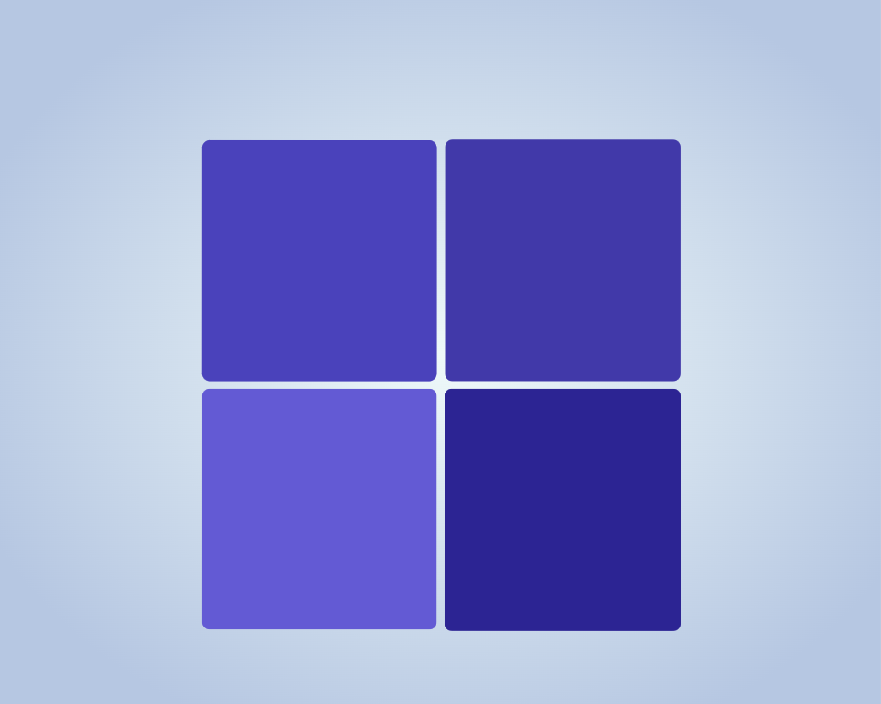


cut1
cut2
box1
box2
box3
box4

Slide 3
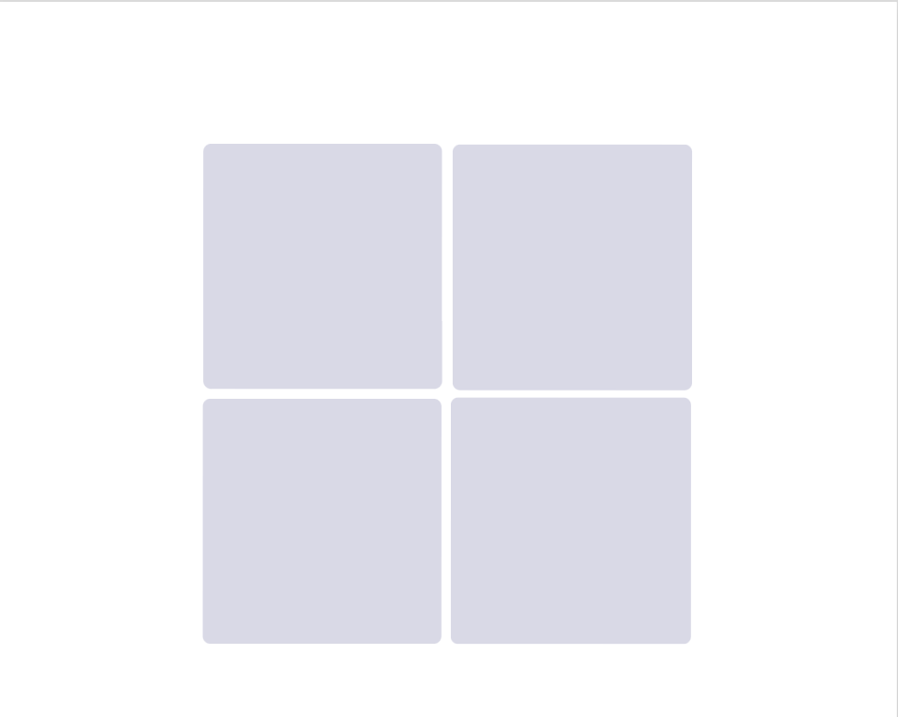
cut1
cut2
box1
box2
box3
box4

Slide 4


